Slide 1



ACADEMIC PROJECT · OOP IN C++
Hospital Resource & Patient
Management System
With Emergency Bed Allocation
Name | Register Number
Mohammed Farmanullah R | 1972260040
B. Balasuriya | 1911260010
Bala Ashwin R | 1921260102
Object Oriented Programming in C++ —
Faculty: Dr. Parimala Kanaga Devan .K · Slot: D

Slide 2


INTRODUCTION
Why Hospital Resource Management Matters
Hospital resource management is essential for delivering timely, high-quality care. Unexpected bed shortages create dangerous delays during critical emergencies and degrade patient outcomes. Manual tracking leads to resource mismatches and long wait times.
This project implements an automated, real-time bed and patient management system in C++ — increasing responsiveness and reducing human error across hospital operations.

Slide 3
PROBLEM STATEMENT
Three Core Challenges
Manual Constraints
Emergency Delays
Operational Inefficiency
Paper-based or siloed digital records make it difficult to maintain accurate, up-to-date bed status across wards.
Poor coordination between departments frequently causes dangerous delays in emergency bed allocation.
Resource mismatches and duplicated work reduce utilization and increase patient waiting times.

Slide 4
PROJECT OBJECTIVES
What We Set Out to Build
Automate Tracking
Emergency Allocation
Secure Records
Real-time bed availability across all wards — no guesswork.
Instant bed assignment based on assessed priority and severity.
Structured digital storage with controlled access to protect patient data.
Reduce Waiting
Live Updates
Minimize wait times and correct misallocation through workflow automation.
Continuous status updates for administrative and medical staff.

Slide 5
EXISTING VS. PROPOSED
From Manual Bottlenecks to Smart Automation
Existing System
Proposed System
Heavy reliance on manual bed monitoring and static paper logs
Delayed emergency allocation with higher risk of human error
Manual registration limits traceability and responsiveness
Real-Time Tracking: Instant bed availability updates across all wings
Smart Triage: Priority-based emergency allocation for critical patients
Digital Workflows: Automated registration and secure digital records
OOP Design: Modular C++ classes with efficient data structures
Key gap: No single source of truth for bed status across the hospital.

Slide 6
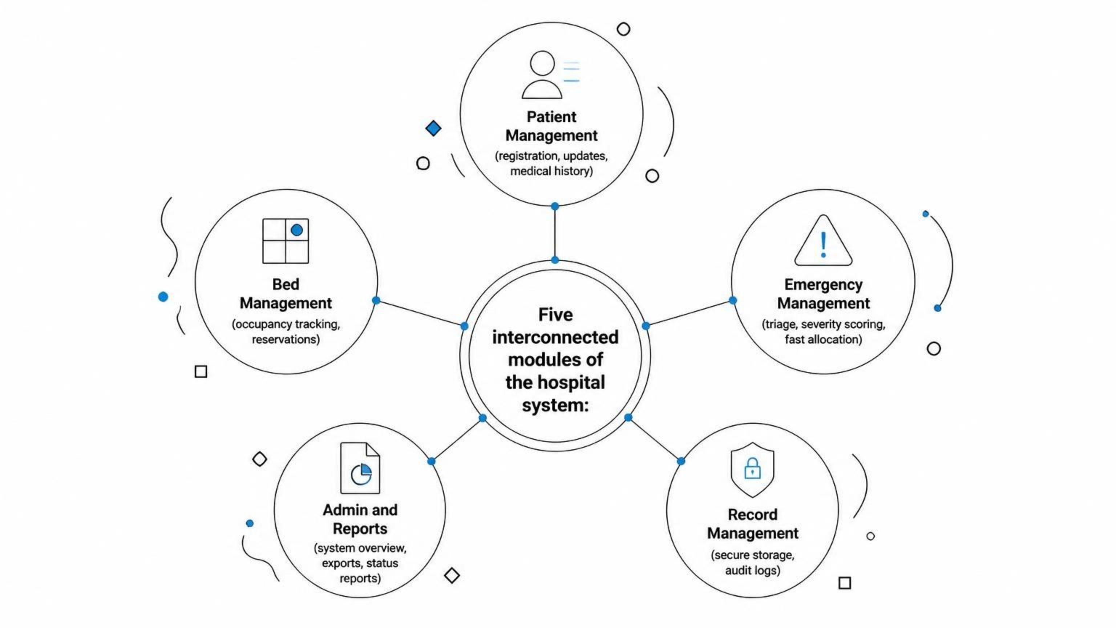
SYSTEM ARCHITECTURE
Five Integrated Modules
The system is organized into five modules, each responsible for a distinct operational layer — from patient intake and bed tracking to emergency triage, administrative reporting, and secure record management.

Slide 7
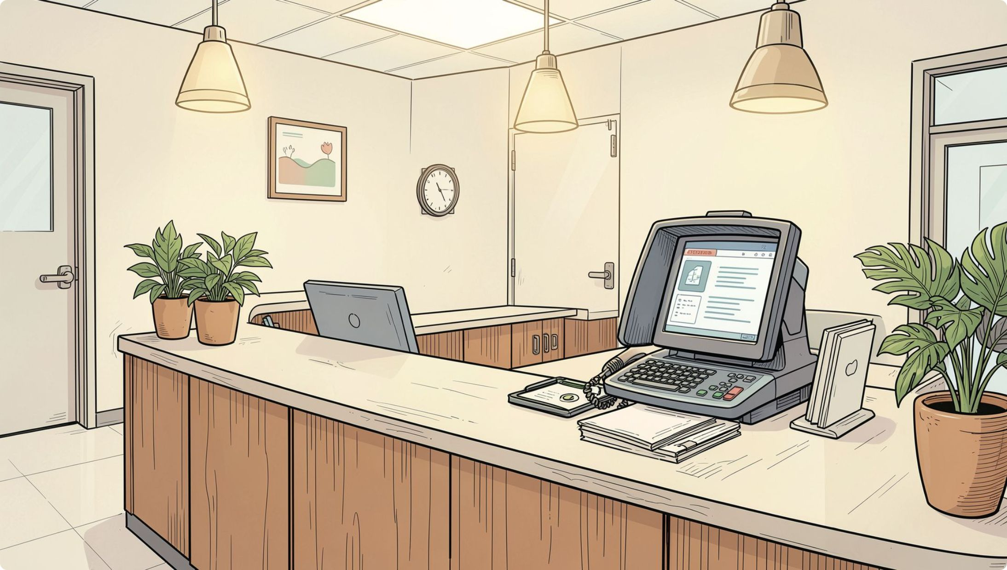
MODULE 1
Patient Management
Digital Registration
Fast enrollment into a centralized database with input validation.
Data Integrity
Comprehensive capture of demographics and medical history.
Dynamic Updates
Real-time edits as patient condition or treatment changes.
Record Control
Single-terminal access with role-based permission controls.
Error Reduction
Lower duplication and manual-entry errors across the system.

Slide 8
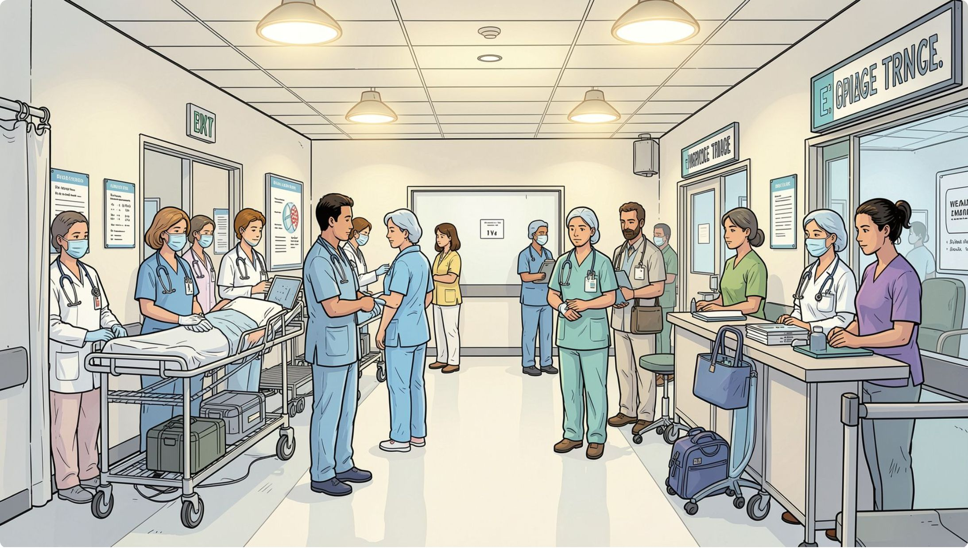

MODULE 2
Emergency Priority & Automated Triage
The Automated Triage Module computes priority scores from vital signs, presenting complaint, and contextual clinical rules. Higher scores receive top allocation priority — reducing time-to-bed for the most critical cases.
Priority logic is modular and extensible — easy to tune for different clinical policies without rewriting core allocation code.
Vital Signs Input
Score Computation
Priority Queue

Slide 9
MODULE 3
Bed Management
Maintains up-to-the-second bed status across wards — available, occupied, reserved, or under maintenance. Live dashboards enable staff to reserve suitable beds, visualize ward load, and trigger automated notifications when beds free up.
Occupancy Dashboard
Reservation Queueing
Sensor Integration
Filter by ward and bed type for a live, hospital-wide view.
Automatic expiration prevents stale holds and frees beds promptly.
Designed for future IoT-based bed state updates with minimal changes.

Slide 10

SUMMARY
Key Takeaways
1
OOP in Practice
C++ classes, inheritance, and encapsulation applied to a real-world healthcare problem.
2
Modular Design
Five independent modules with clear responsibilities and clean interfaces.
3
Scalable Architecture
Built to extend — new triage rules, wards, and integrations added without rework.
4
Real Impact
Addresses genuine hospital pain points: delays, errors, and lack of visibility.

Slide 11
MODULE 4
Resource Allocation
System-assigned priority scores drive allocation so critical cases are routed first, ensuring ethical, auditable decisions during surges.
Intelligent Matching
Priority Logic
Optimization
Automatically match patient clinical needs to appropriate available resources — beds, equipment, and specialty staff — reducing manual lookup time.
System-assigned priority scores drive allocation so critical cases are routed first, ensuring ethical, auditable decisions during surges.
Continuous optimization improves bed utilization and shortens emergency response times by matching throughput patterns to capacity in real time.
The module reduces mismatches between patient need and resource capability, increasing throughput and improving outcomes.

Slide 12
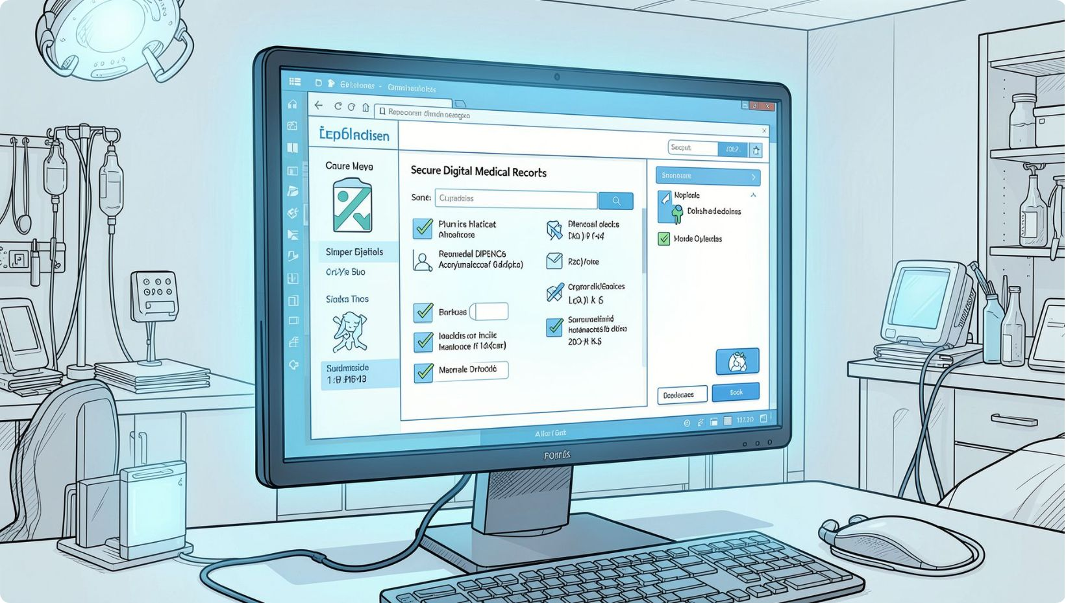
MODULE 5
Patient Records
Secure Storage
All sensitive patient data is stored locally with strong file-backed protections. Access is role-based and logged for full auditability.
Easy Modification & Instant Access
Safe, atomic updates prevent data corruption; clinicians retrieve complete patient histories instantly to support faster, more informed decision-making.
C++ Integration & Confidentiality
The backend uses C++ file handling for persistence and performance, with architecture specifically designed to maintain confidentiality and data integrity.

Slide 13


MODULE 6
Admin & Reports
The proposed system dramatically improves allocation speed and record accuracy compared to legacy manual methods. The Admin Module gives staff a live view of bed availability, patient status, and system metrics. Generate customizable management reports for capacity planning and compliance.
Customizable reports support capacity planning, regulatory compliance, and executive-level decision-making.

Slide 14
System Use Case
Actors
Main Use Cases
01
Patient
Hospital Staff
Register patient & capture vitals
Emergency Staff
Administrator
02
Check bed availability
03
Assess emergency priority
04
Allocate bed and update status
05
Manage records & generate reports

Slide 15
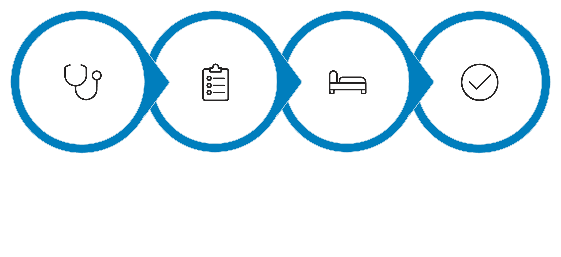
System Workflow
This workflow ensures consistent triage, transparent allocation, and durable record updates — ideal for emergency and routine admissions.
Triage
Input
Allocation
Finalize

Slide 16
C++ Concepts Used
Core OOP
Data Structures
Control & Storage
Classes and encapsulation for Patient, Bed, and Allocation logic; inheritance for specialized roles.
Queues manage waitlists; arrays and maps track bed state and resource metadata efficiently.
Conditional routing for triage decisions and robust C++ file handling for persistent, tamper-resistant storage.

Slide 17
Inside the Codebase
Embedded Web Server
Single-Page Dashboard
File-Backed Persistence
A WinSock2 HTTP server on port 8080 serves the dashboard and a lightweight JSON API directly from the compiled C++ binary — no external framework.
One generated HTML/CSS/JS page renders live cards, tables and the 50-bed grid, polling /api/dashboard every 5 seconds for real-time updates.
Beds and resources are serialized to pipe-delimited text files and reloaded on startup; every action is timestamped into an audit log.

Slide 18
How Priority Scoring Works
Vitals Scoring
Complaint Keywords
Priority Bands
Oxygen, heart rate and blood pressure each add weighted points — e.g. SpO₂ below 85% adds 40 points, systolic BP below 80 adds 25.
The presenting complaint is scanned for terms like chest, stroke, breathing and unconscious, each adding 25–35 points on a match.
Scores are capped at 100 and mapped to bands — CRITICAL ≥80, HIGH ≥60, MEDIUM ≥35, LOW below — driving allocation to ICU, Emergency or General wards.

Slide 19
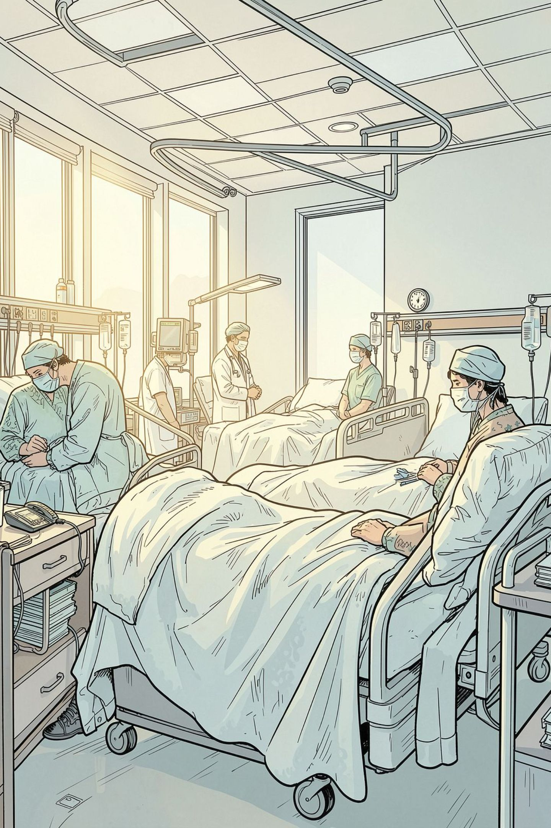
System Advantages
Rapid Action
Automated triage shortens response times and routes critical patients faster.
High Efficiency
Improved bed utilization cuts waiting times and increases throughput.
Total Control
Administrators get centralized visibility and actionable reports for decision-making.
Confidentiality & Scalability
File-backed storage protects sensitive data and the modular C++ design supports incremental scaling.

Slide 20
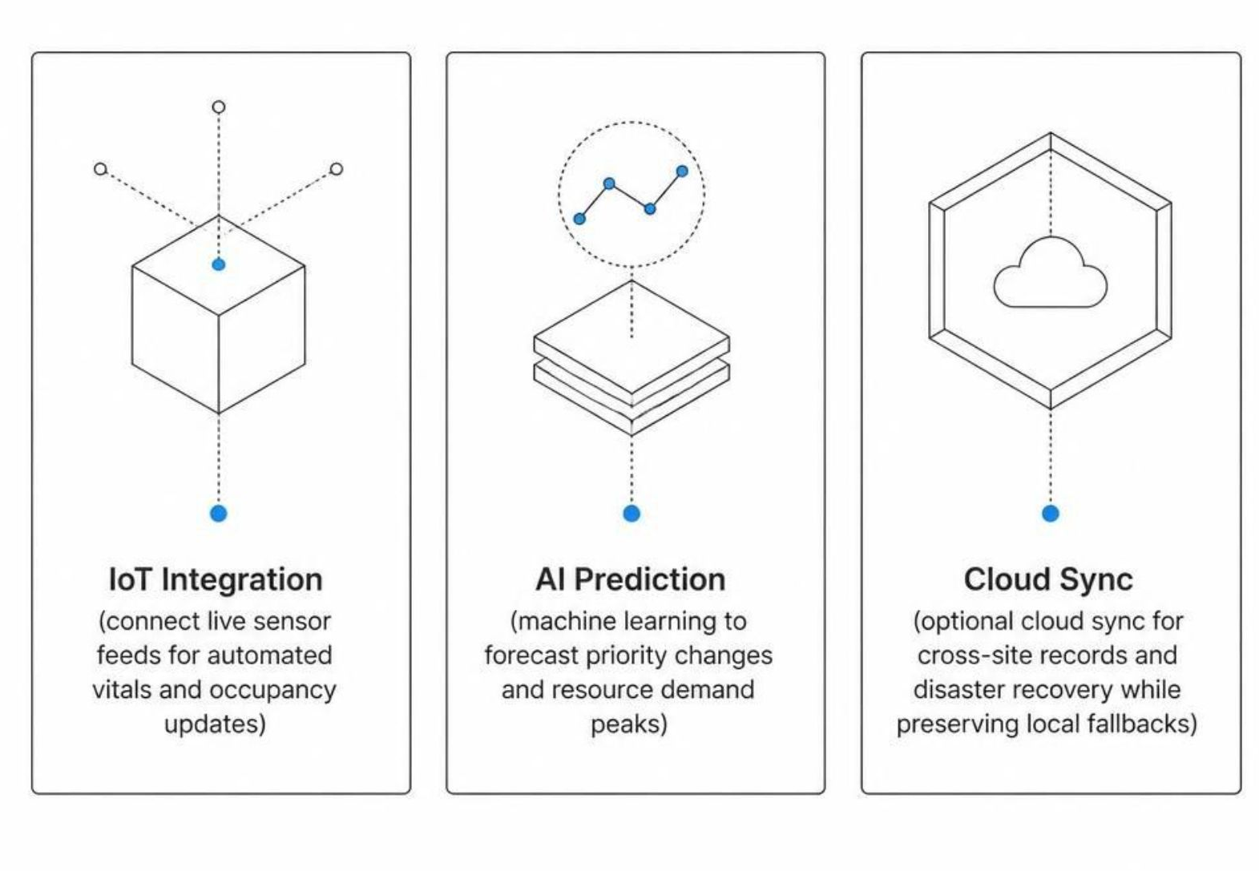
Future Scope & Enhancements
The system's modular C++ architecture is designed to grow with your organization. Planned enhancements will extend capabilities in three key directions.

Slide 21
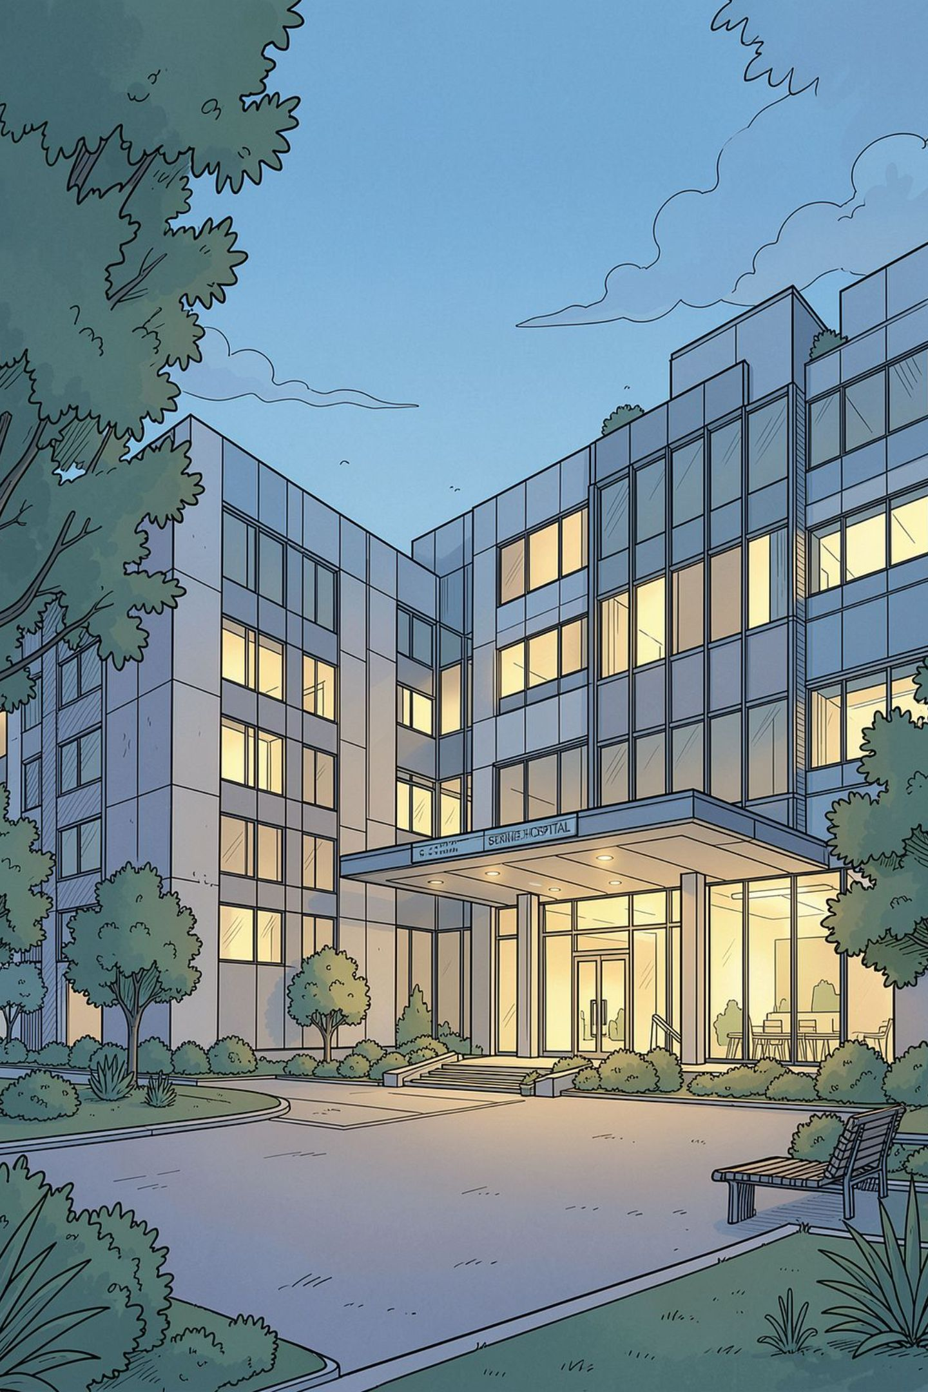
Conclusion
The proposed C++-based system delivers real-time bed tracking, priority-driven allocation, and robust local record storage. The result: fewer allocation delays, faster emergency care, better utilization, and a modular foundation ready for AI, IoT, and cloud enhancements.
Thank You
Questions? Contact the project lead to discuss implementation timelines, pilot scope, and resource needs.

Slide 22

Thank You
We appreciate your time and consideration. This system is designed to improve care delivery, streamline operations, and support better outcomes for every patient.

